Slide 1
Implementation of
Multi-layer Perceptron: MLP

Slide 2
Agenda
MLP basics
MLP forward and backward pass implementation
Other Implementation issues
API style
Assignment requirements

Slide 3
MLP Basics

Slide 4
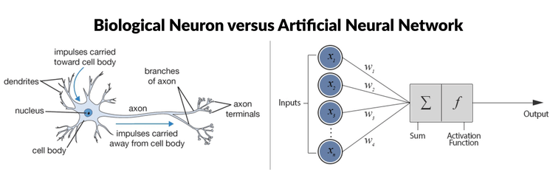
ANN

Slide 5
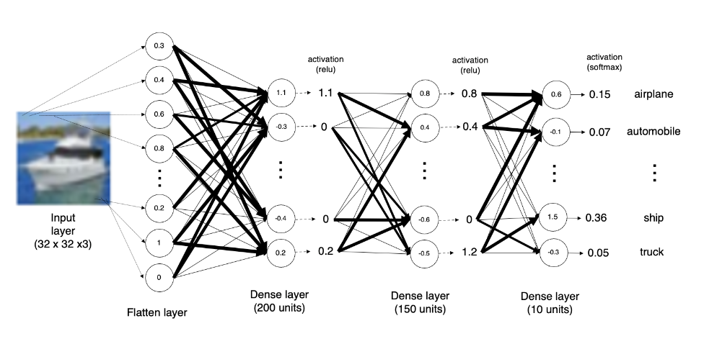
MLP Example
Keras: Multilayer Perceptron (MLP) Example

Slide 6




















Forward pass (Forward-propagation)
$$z_{i}=\sum_{j=0}^{n}{w_{1ij}x_{i}}+b_{1}$$
$$a_{i}= Sigmoid(z_{i})$$
$$p_{1}=\sum_{i=0}^{n}{w_{2i}a_{i}}+b_{2}$$
$$y_{1}= Sigmoid(p_{1})$$
$$x_{1}$$
$$a_{1}$$
$$x_{2}$$
$$a_{2}$$
$${\hat{y}}_{1}$$
$$y_{1}$$
$$x_{3}$$
$$a_{3}$$
$$x_{4}$$
$$a_{4}$$
$Loss=L(y_{1},$ ${\hat{y}}_{1})$

Slide 7









N-layer Perceptron (MLP) + Softmax
$$x_{i}=[x_{i1} { x}_{i2} x_{i3} { x}_{i4}]$$
$$y_{i}=$$
[1 0 0]
$${\hat{y}}_{i}= [f_{c} f_{d} f_{b}]$$
$$a_{1}=sigmoid(w_{[1]}x^{T}+b_{[1]}^{T})$$
$$a_{2}=sigmoid(w_{[2]}a_{1}^{T}+b_{[2]}^{T})$$
$$…$$
$$a_{k}=sigmoid(w_{[k]}a_{k−1}^{T}+b_{[k]}^{T})$$
$$…$$
$$f=softmax(w_{[n]}a_{n−1}^{T}+b_{[n]}^{T})$$

Slide 8




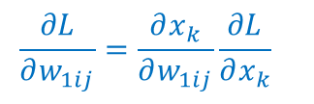


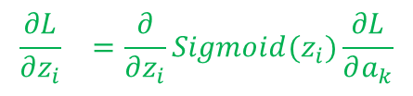


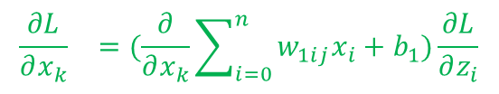




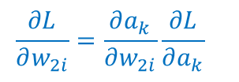





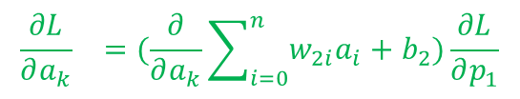
Backward pass (Back-propagation)
$${\frac{∂L}{∂x_{k}}}_{}=(\frac{∂}{∂x_{k}}\sum_{i=0}^{n}{w_{1ij}x_{i}}+b_{1})\frac{∂L}{∂z_{i}}$$
$${\frac{∂L}{∂z_{i}}}_{}=\frac{∂}{∂z_{i}}Sigmoid(z_{i})\frac{∂L}{∂a_{k}}$$
$${\frac{∂L}{∂a_{k}}}_{}=(\frac{∂}{∂a_{k}}\sum_{i=0}^{n}{w_{2i}a_{i}}+b_{2})\frac{∂L}{∂p_{1}}$$
${\frac{∂L}{∂p_{1}}}_{}=\frac{∂}{∂p_{1}}Sigmoid(p_{i})$ $\frac{∂L}{∂{\hat{y}}_{1}}$
$$x_{1}$$
$$a_{1}$$
$$x_{2}$$
$$a_{2}$$
$${\hat{y}}_{1}$$
$$y_{1}$$
$$x_{3}$$
$$a_{3}$$
$$x_{4}$$
$$a_{4}$$
$${\frac{∂L}{∂w_{2i}}=\frac{∂a_{k}}{∂w_{2i}}\frac{∂L}{∂a_{k}}}_{}$$
$\frac{∂L}{∂{\hat{y}}_{1}}=\frac{∂}{∂{\hat{y}}_{1}}L(y_{1},$ ${\hat{y}}_{1})$
$${\frac{∂L}{∂w_{1ij}}=\frac{∂x_{k}}{∂w_{1ij}}\frac{∂L}{∂x_{k}}}_{}$$

Slide 9
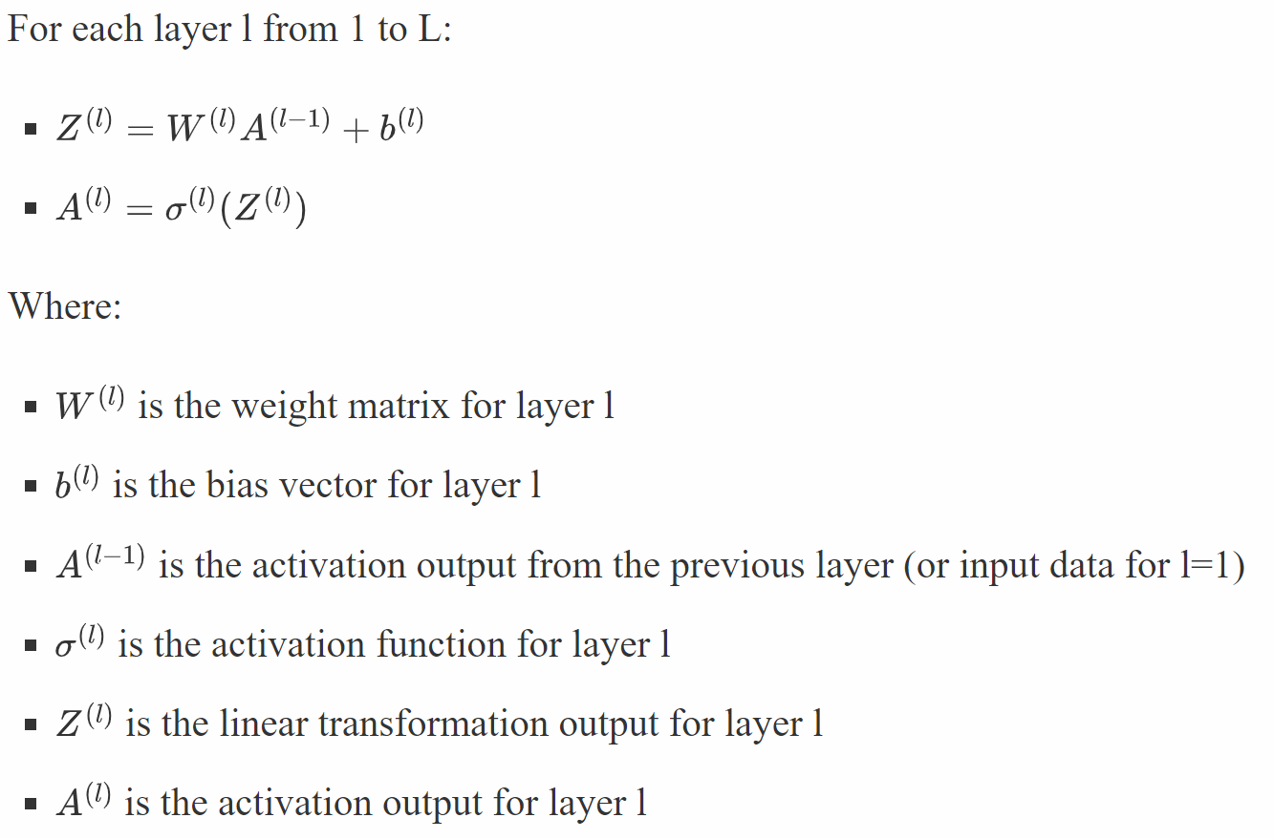
Summary of MLP forward pass
For a Multi-Layer Perceptron (MLP) with L layers, the forward propagation can be described as follows:

Slide 10
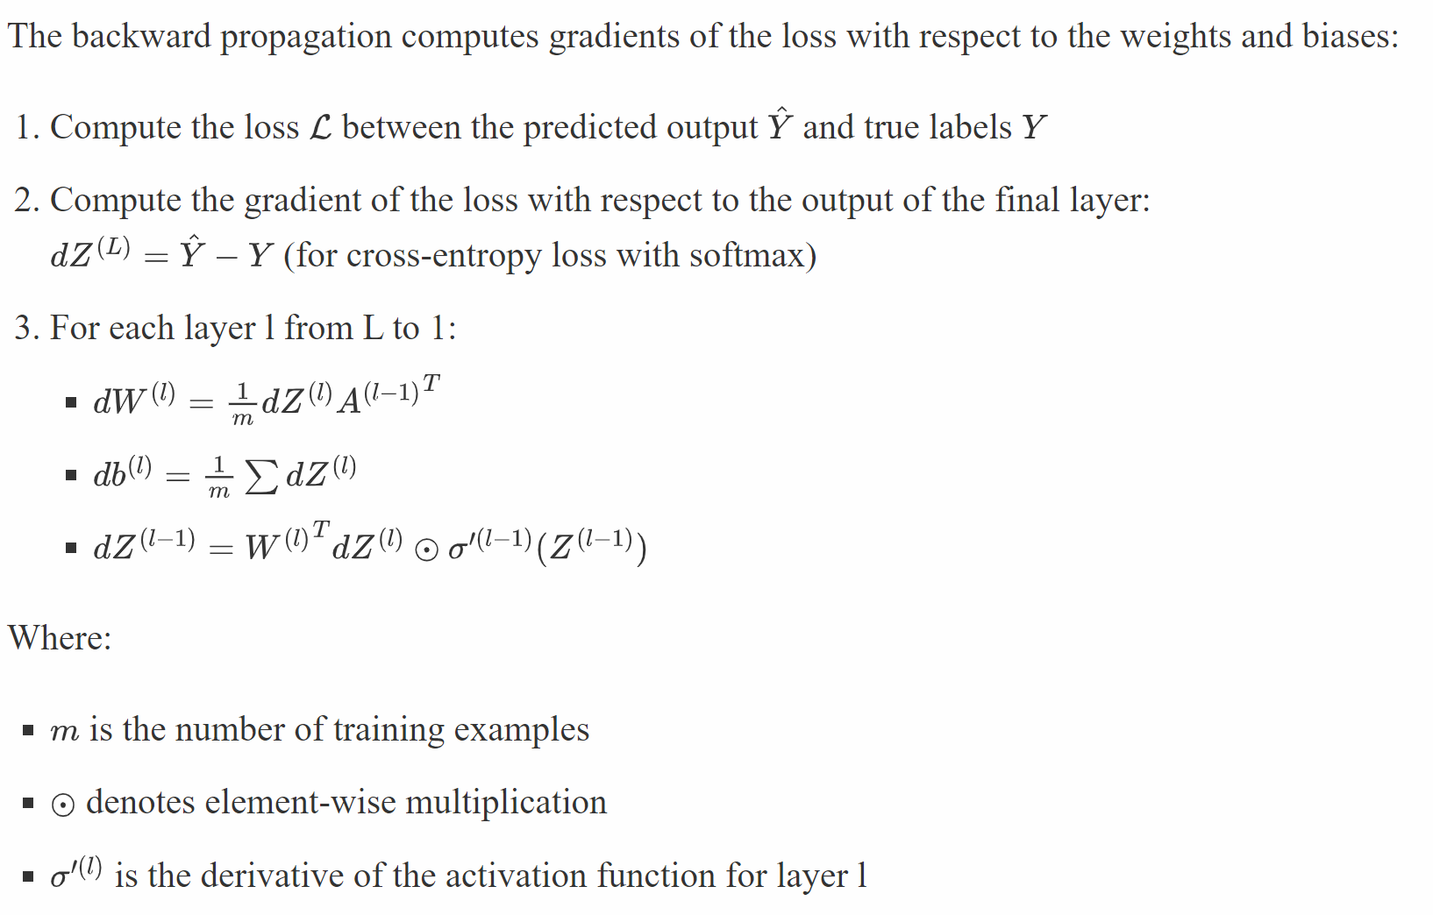
Summary of Back pass

Slide 11
MLP Implementation

Slide 12
Essential Points
Initialization
MLP training process
Implementation of forward pass and back pass
SGD early stopping criteria
SGD optimizer
Weight initialization algorithms
Activations
Regularization

Slide 13
Weight Initialization for Sigmoid and Tanh
Xavier Weight Initialization
weight = U [-(1/sqrt(n)), 1/sqrt(n)]
The xavier initialization method is calculated as a random number with a uniform probability distribution (U) between the range -(1/sqrt(n)) and 1/sqrt(n), where n is the number of inputs to the node.
Normalized Xavier Weight Initialization
weight = U [-(sqrt(6)/sqrt(n + m)), sqrt(6)/sqrt(n + m)]
where n is the number of inputs to the node (e.g. number of nodes in the previous layer) and m is the number of outputs from the layer (e.g. number of nodes in the current layer).
https://machinelearningmastery.com/weight-initialization-for-deep-learning-neural-networks/

Slide 14
Weight Initialization for ReLU
The “xavier” weight initialization was found to have problems when used to initialize networks that use the rectified linear (ReLU) activation function.
The current standard approach is called “he” initialization, named for Kaiming He, currently a research scientist at Facebook, and was described in the 2015 paper by Kaiming He, et al. titled “Delving Deep into Rectifiers: Surpassing Human-Level Performance on ImageNet Classification.”
weight = G (0.0, sqrt(2/n))
The he initialization method is calculated as a random number with a Gaussian probability distribution (G) with a mean of 0.0 and a standard deviation of sqrt(2/n), where n is the number of inputs to the node.

Slide 15
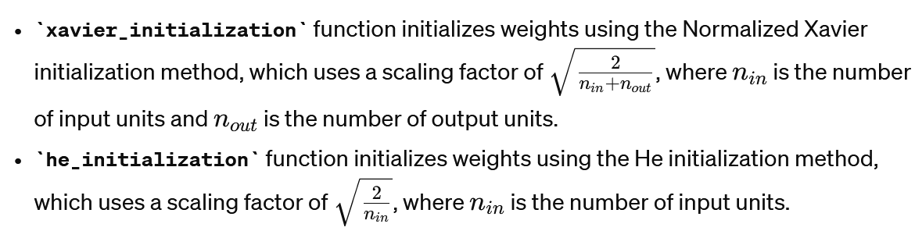
Weights initialization

Slide 16
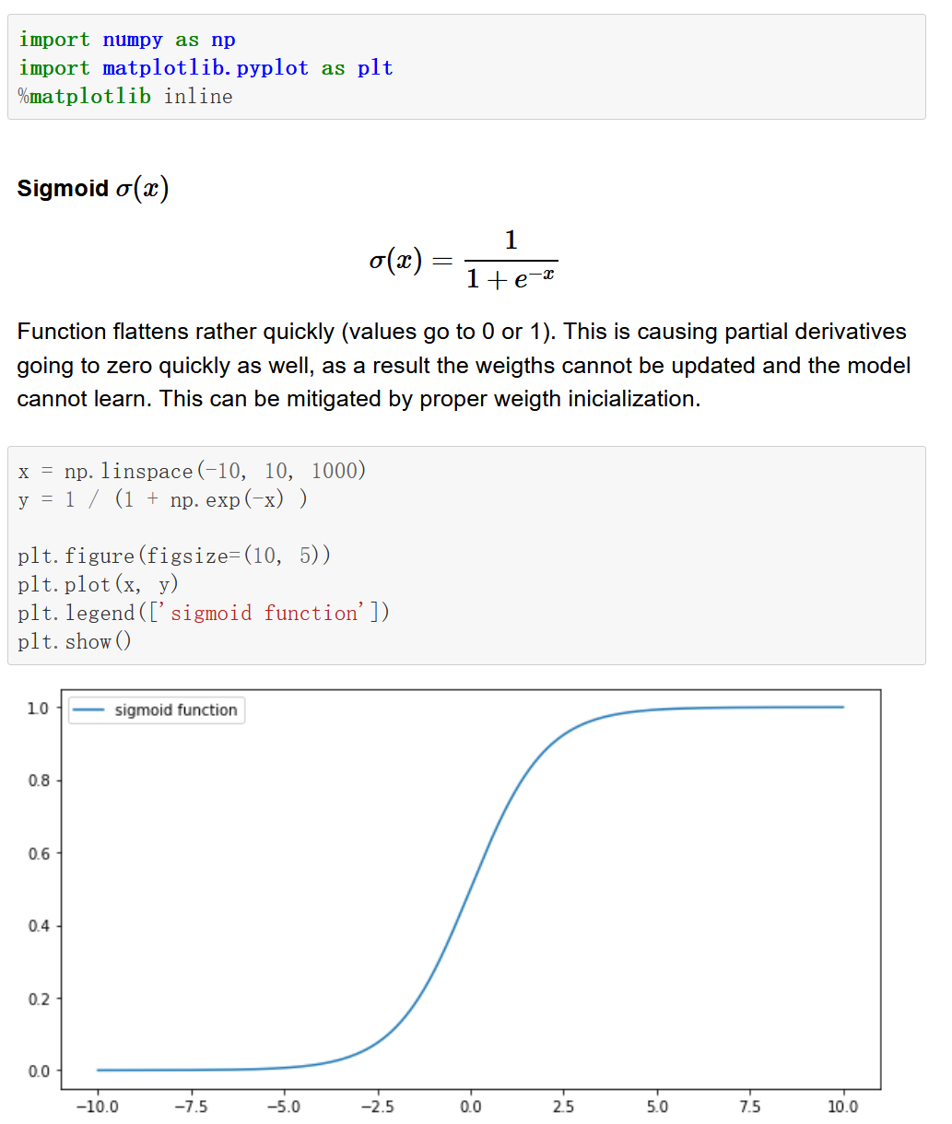
Activation Function – Sigmoid, Tanh, Relu
https://tcoil.info/activation-functions-sigmoid-tanh-relu/
Notes:
https://tcoil.info/activation-functions-sigmoid-tanh-relu/
https://www.analyticsvidhya.com/blog/2021/04/activation-functions-and-their-derivatives-a-quick-complete-guide/

Slide 17
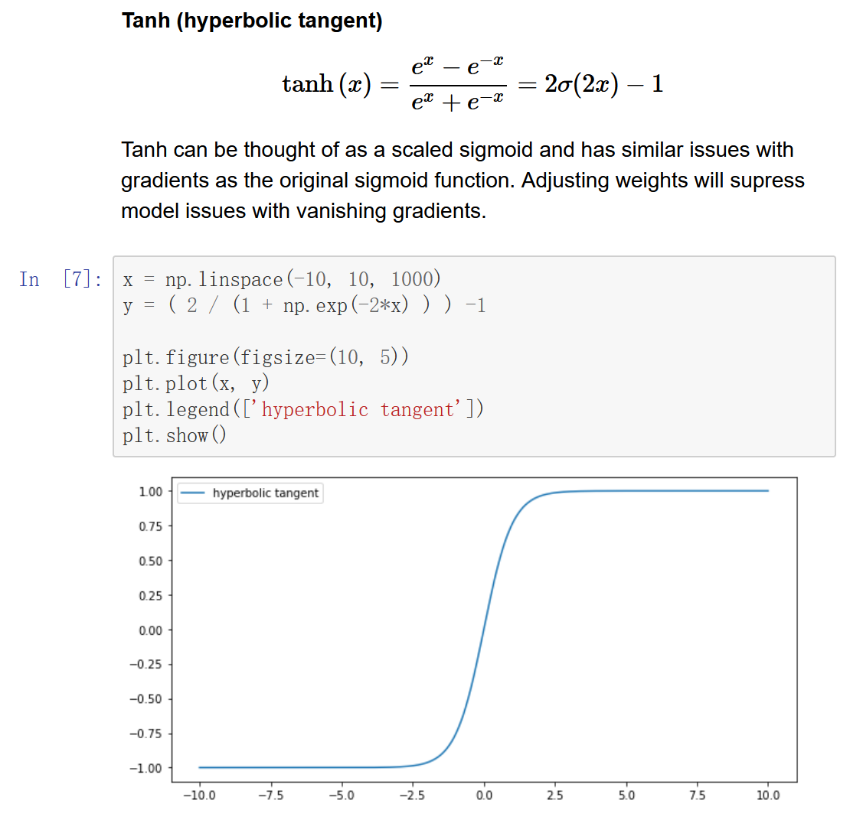
Activation Function – Sigmoid, Tanh, Relu

Slide 18
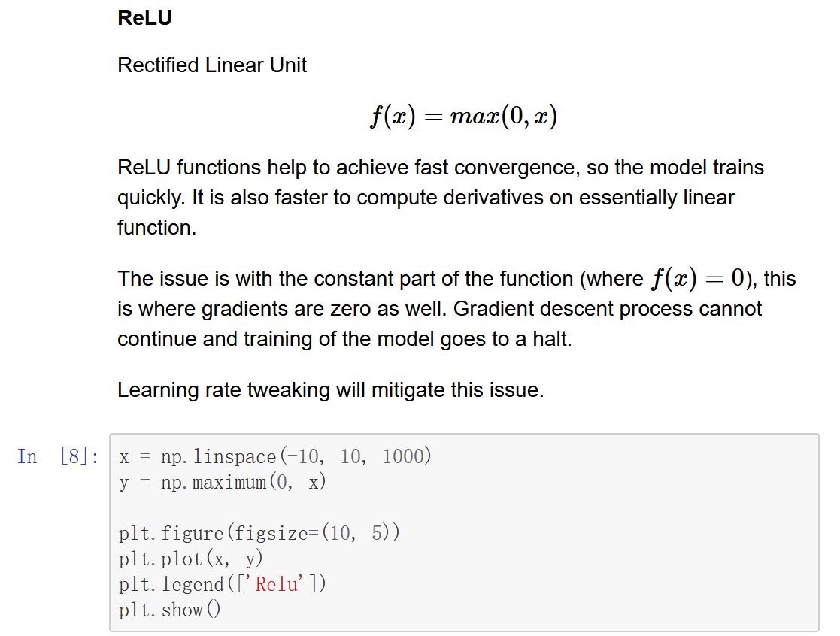
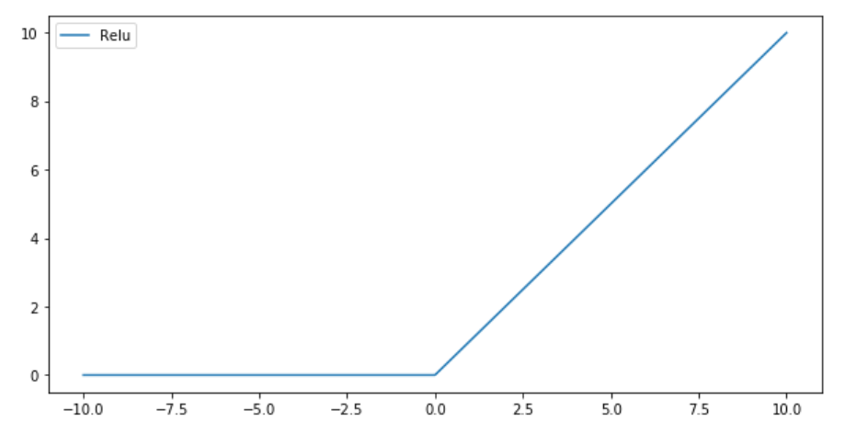
Activation Function – Sigmoid, Tanh, Relu

Slide 19
Regularization
Regularization in Multilayer Perceptron (MLP) training is a technique used to prevent overfitting.
The Idea of Regularization
The core idea of regularization is to penalize large weights in the MLP. Large weights often indicate that the model is overfitting by memorizing specific patterns in the training data rather than learning generalizable features. By penalizing large weights, regularization encourages the model to learn simpler, smoother decision boundaries that generalize better to new data.

Slide 20
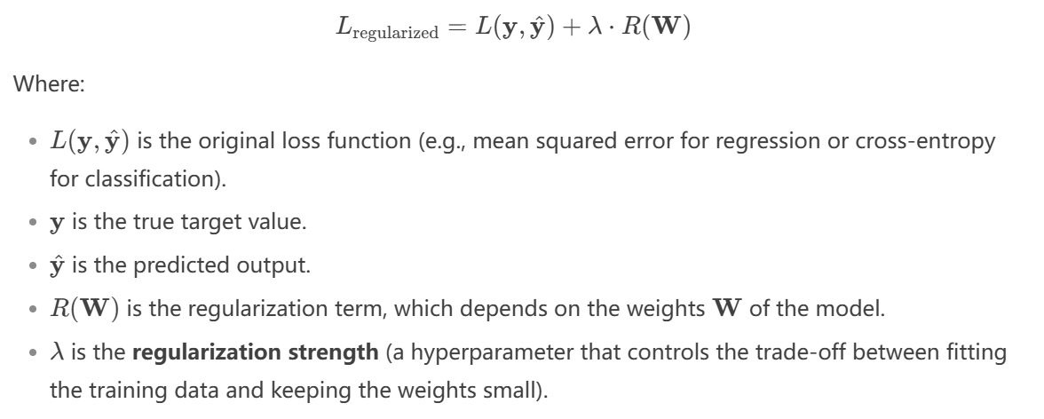
Regularization
Regularization modifies the loss function used during training by adding a penalty term that depends on the magnitude of the model's weights. The modified loss function is:

Slide 21
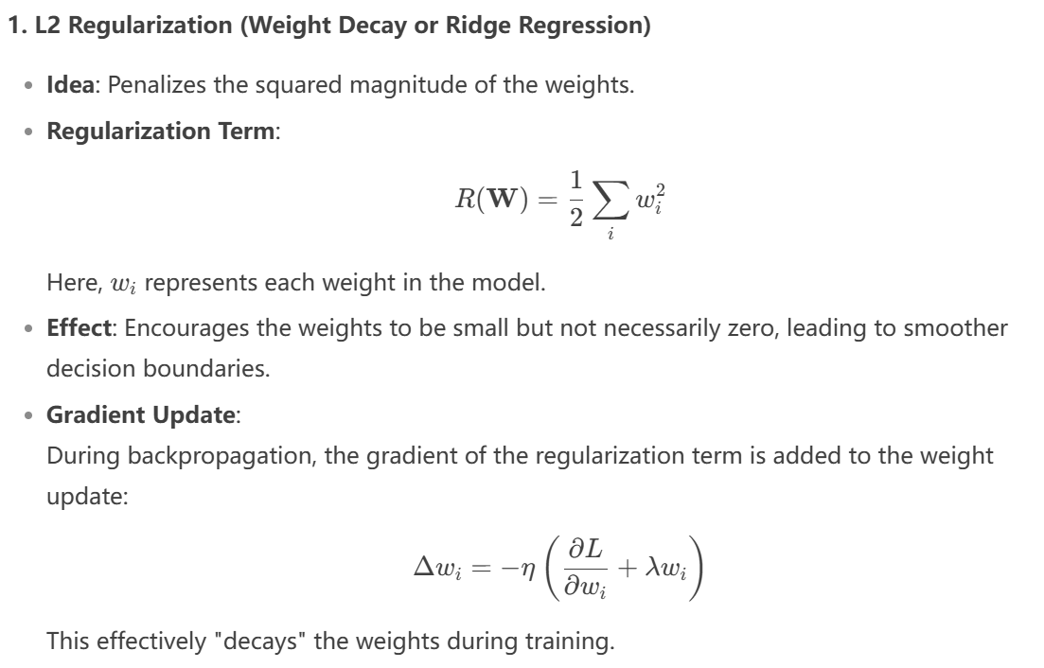
L2 Regularization (Weight Decay or Ridge Regression)

Slide 22
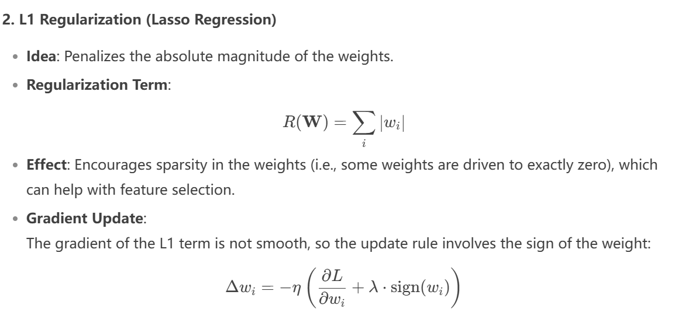
L1 Regularization (Lasso Regression)

Slide 23
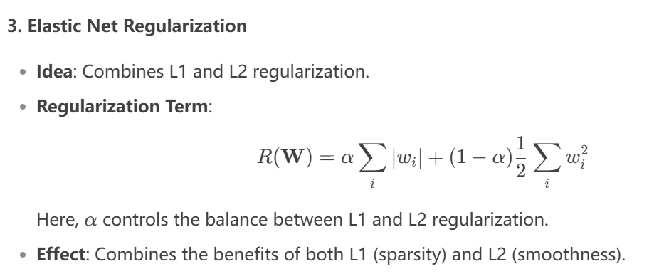
Elastic Net Regularization

Slide 24
Why Regularization Works
Prevents Overfitting: By penalizing large weights, regularization discourages the model from fitting noise or overly complex patterns in the training data.
Improves Generalization: Regularization encourages the model to learn simpler, more generalizable patterns that perform well on unseen data.
Controls Model Complexity: Regularization acts as a constraint on the model's capacity, effectively reducing its complexity.

Slide 25
API Style

Slide 26
PyTorch vs Keras API Styles
PyTorch's Imperative/Define-by-Run Style
Keras' Declarative/Define-and-Run Style

Slide 27
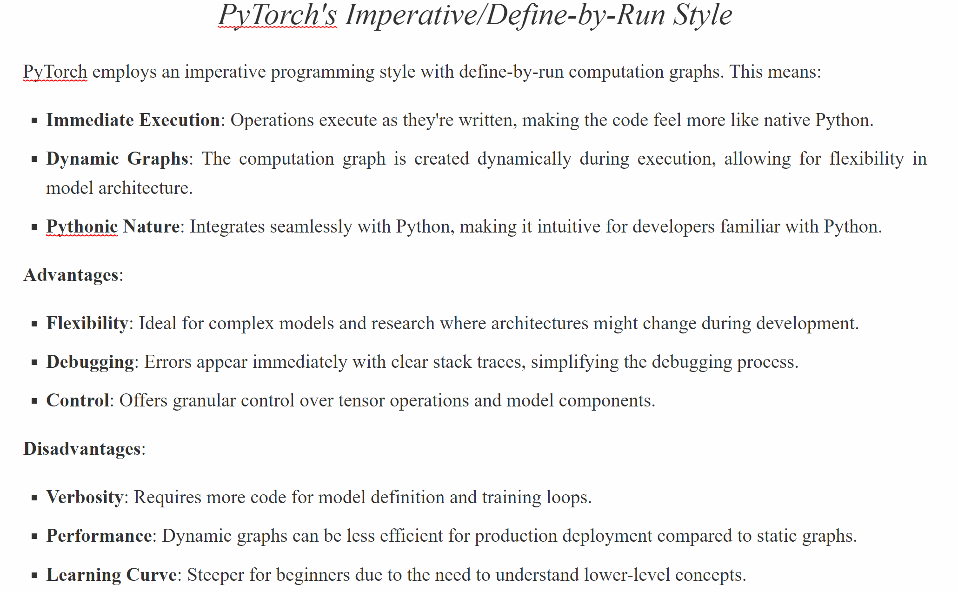

Slide 28
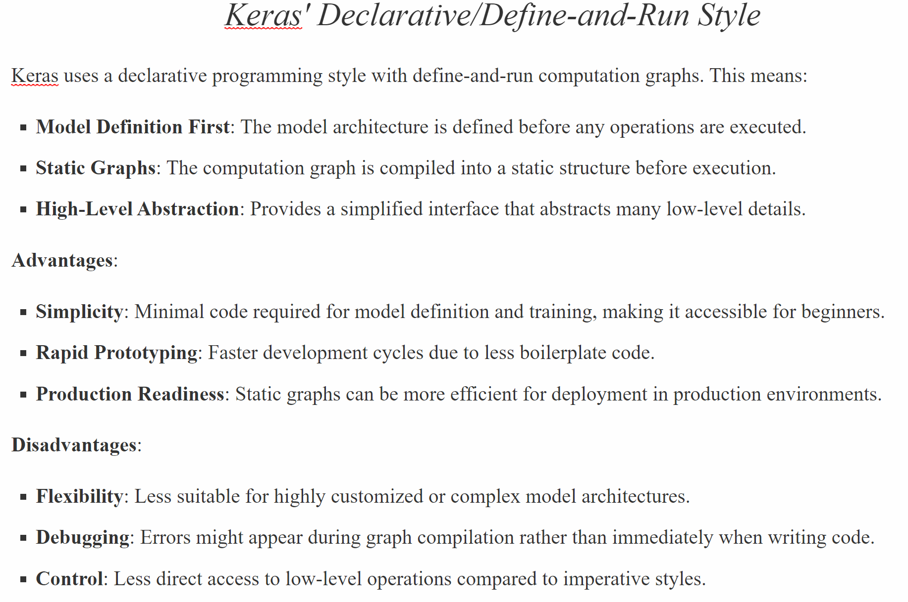

Slide 29
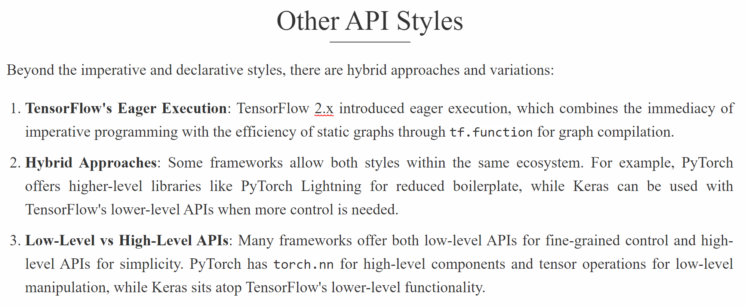

Slide 30
